Slide 1
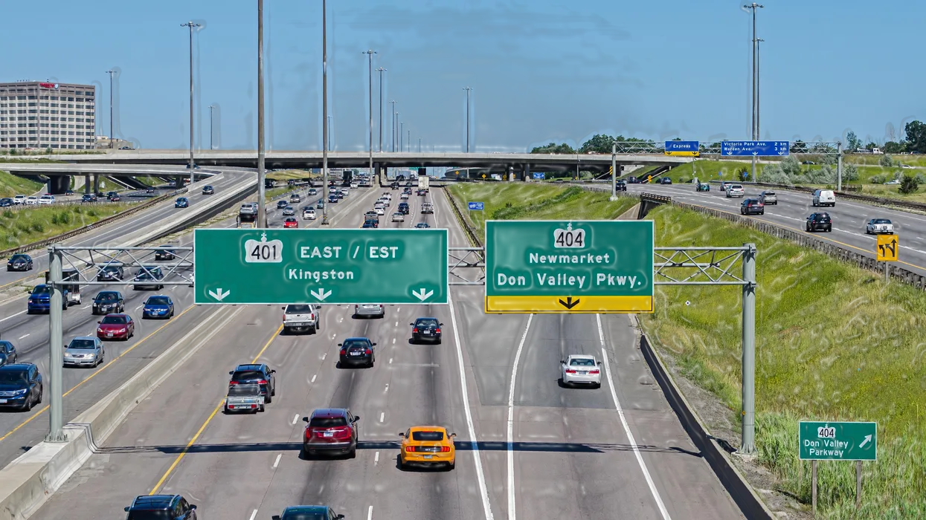
Capstone Project
RAG Models Development
Enhancing Access to Information on Driving Acts in Ontario
Notes:
Hello Everyone.
Whether you're new to Canada or have been living here for a while, one thing is certain: eventually, everyone will need a driver's license and will need to navigate the roads.
Accessing the right information on driving acts can sometimes feel overwhelming.
Ontario has a wonderful website with helpful information. BUT, you will find yourself navigating through a series of links and pages that can be frustrating, especially if you're in a hurry.

Slide 2
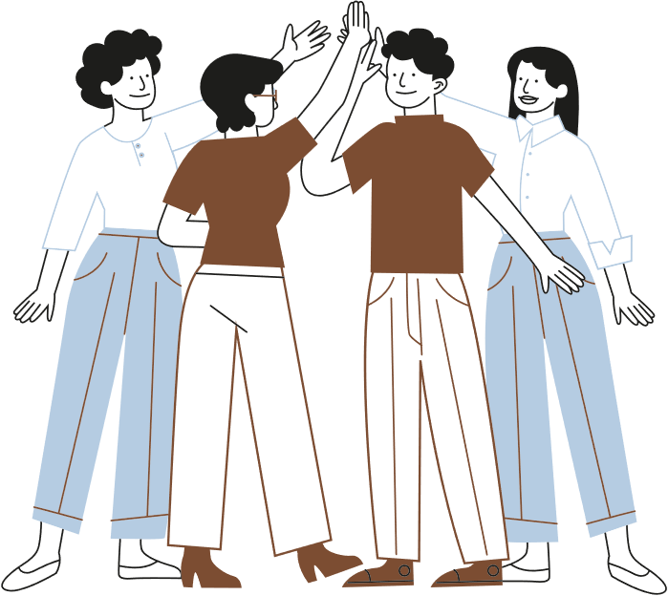
Team Members
Abinayaa Uthayakumar
Vijaya Shanthi Alaguraj
Joshua Yap
Shabana Sheikh

Slide 3
Workload Distribution
Tasks and responsibilities distributed evenly among the four members of the group.
Collaborative execution of all steps in developing the RAG NLP model.
Ensures comprehensive understanding of each phase for all members.
Promotes shared contribution to the project's overall success

Slide 4
Agenda
Objective
Data Source & Evaluation Questions
Step 1 - Data Collection and Preprocessing
Step 2 Model Development
Step 3 Model Training and Evaluation
Developed Models
Metrics Comparison
Challenges
Future Improvements
Conclusion

Slide 5
Introduction
Streamline Access to Driving-Related Information:
Enable users to quickly find key information about Ontario’s driving laws and regulations without navigating through multiple web pages.
Accelerate Information Retrieval:
Provide fast, easy-to-use and accurate responses to user queries, ensuring timely access to essential details.
Enhance User Engagement and Experience:
Deliver a user-friendly interface with quick and reliable answers, improving overall satisfaction.
Focus on Key Topics:
Prioritize accessibility to crucial topics such as driving rules, licensing requirements, off-road vehicle laws, and road safety guidelines.
Overall Goal
Develop an AI-driven system that utilizes Retrieval-Augmented Generation (RAG) models to provide precise, timely answers about Ontario's driving Acts, enhancing the user experience by eliminating delays caused by complicated website navigation or dense documents..
Notes:
Our project aims to address this issue by creating a model that offers quick and accurate answers to your questions about driving acts in Ontario.
This will make it easier for everyone, to access the information they need efficiently

Slide 6
Step 1: Data Collection and Preprocessing
Data Extraction:
Collect and organize the necessary data from the Ontario government website: https://www.ontario.ca/document/official-mto-drivers-handbook
Highway Traffic Act, Motorized snow Vehicles Act & Off Road Vehicles Act
Data Cleaning:
Address missing values, remove duplicates, removed French text, and correct any inconsistencies in the data. [remove unnecessary links]

Slide 7
Step 2: Model Development
Utilized five distinct models: Zephyer, Llama 3.2, Gemma2, Mistral, and DistillBERT, each contributing uniquely to the overall functionality of retrieving the data from document.
1. Zephyer
Overview: Zephyer is engineered for speed and efficiency, specifically designed to handle high-throughput, low-latency tasks.
Model Weight: Lightweight – Its architecture is optimized for minimal computational load, making it ideal for deployment on edge devices.
Advancements: Incorporates cutting-edge techniques in model compression and optimization to ensure performance without heavy resource consumption.

Slide 8
Step 2: Model Development
2. Llama 3.2
Overview: An advanced natural language processing model that builds on its predecessors by incorporating deeper contextual understanding and broader linguistic knowledge.
Model Weight: Heavyweight – Features a complex and deep network structure that requires substantial computational resources to achieve high accuracy.
Advancements: Improved algorithms for context retention and adaptive learning, enhancing its applicability in diverse linguistic environments.
3. Gemma2
Overview: Designed for robust data handling, Gemma2 excels in managing and analyzing large datasets with enhanced precision and speed.
Model Weight: Moderate – Balances between performance and resource usage, optimized for scalability and efficiency.
Advancements: New algorithms for faster data retrieval and improved anomaly detection capabilities, particularly useful in large-scale industrial applications.

Slide 9
Step 2: Model Development
4. Mistral
Overview: Focuses on image and video analysis, utilizing deep convolutional neural networks to process and interpret visual data.
Model Weight: Heavyweight – Due to its extensive use of deep learning layers for detailed image and video processing.
Advancements: Advanced techniques in image segmentation and real-time video analytics enhance its application in security and multimedia content analysis.
5. DistillBERT
Overview: A distilled version of the original BERT model, designed to maintain robust natural language processing capabilities while significantly reducing computational demands.
Model Weight: Lightweight – Optimized for faster deployment and lower resource consumption compared to its predecessor.
Advancements: Retains most of the original BERT’s effectiveness in understanding and generating human-like text, while being more efficient in terms of speed and memory usage.

Slide 10
Step 2: Model Development
Model Name | Architecture | Model Size | Parameter Count | Primary Use Case | Training Dataset | Key Features
LLama 3.2 | Transformer-based | Large (2 GB) | 3.2 billion | General-purpose language model | Diverse datasets (unspecified) | Efficient, capable of high-quality text generation and understanding.
Gemma 2 | Transformer-based | Medium (1.6 GB) | ~2 billion | Conversational AI, Text Summarization | Pretrained on general conversational data | Tailored for conversation and summarization tasks.
Mistral-7B-Instruct-v0.1 | Transformer-based | 7B | 7 billion | Instruction-following tasks | Instructional data (designed for tasks with clear goals) | Optimized for tasks requiring instruction following and robust reasoning.
distilbert-base-uncased-distilled-squad | BERT-based (Distilled) | Medium (66M) | 66 million | Question answering, Text classification | SQuAD dataset | Lightweight, optimized for speed with a focus on question answering.
Zephyr-7B-Beta | Transformer-based | 7B | 7 billion | Natural language understanding, Text generation | General-purpose training with fine-tuning | Fine-tuned for understanding and generating coherent responses across domains

Slide 11
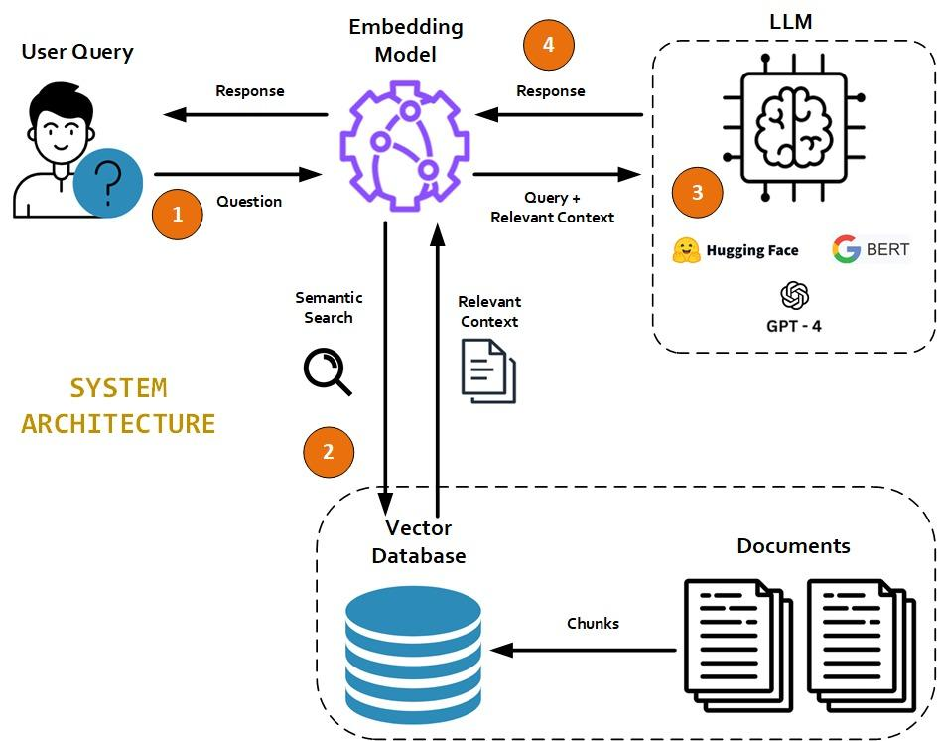
Architectural Design

Slide 12
Step 3: Model Training and Evaluation
Model Training Plan (using NLP RAG):
Training Data: Used data from the 3 acts (Highway Traffic Act, Motorized Snow Vehicles Act, Off-Road Vehicles Act) as the training dataset.
Evaluation Data: Created an Excel file with 140 questions and correct answers for model evaluation.
Model Testing: Included trick questions designed to test and identify model hallucinations.
Evaluation Purpose: Ensured that the models provide accurate answers while handling ambiguous or misleading queries.

Slide 13
Step 3: Model Training and Evaluation cont’d
Evaluation Plan:
Accuracy Testing: Evaluate the model’s performance using real user queries, measuring how accurately the generated answers align with the actual data.
Response Time & Memory: Test & compare the speed of each model’s response & memory usage.
Metrics: Evaluate performance using Cosine similarity, ROUGE-L , and to ensure key content is accurately retrieved and generated.

Slide 14
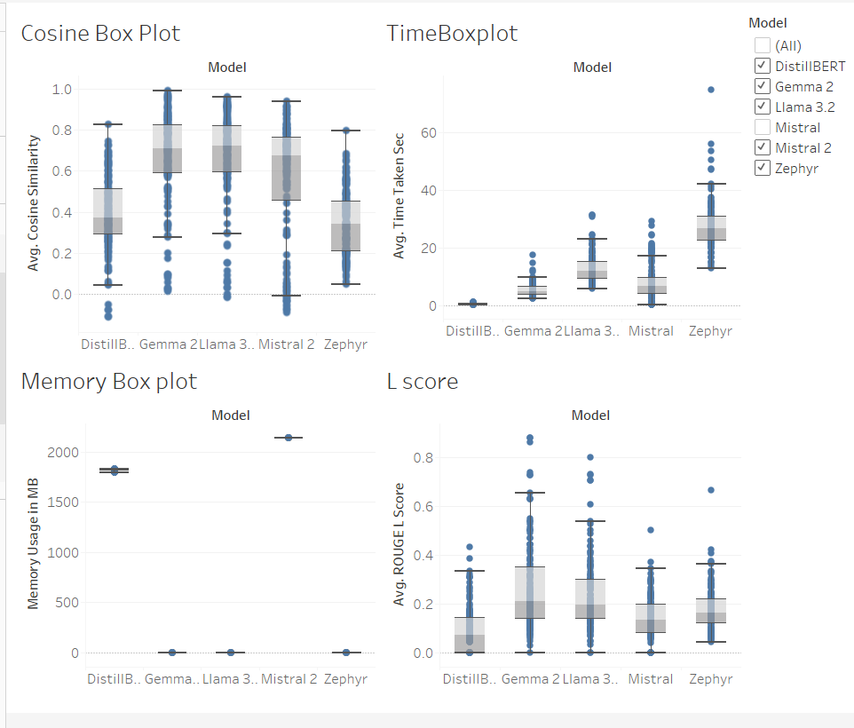
Metrics

Slide 15
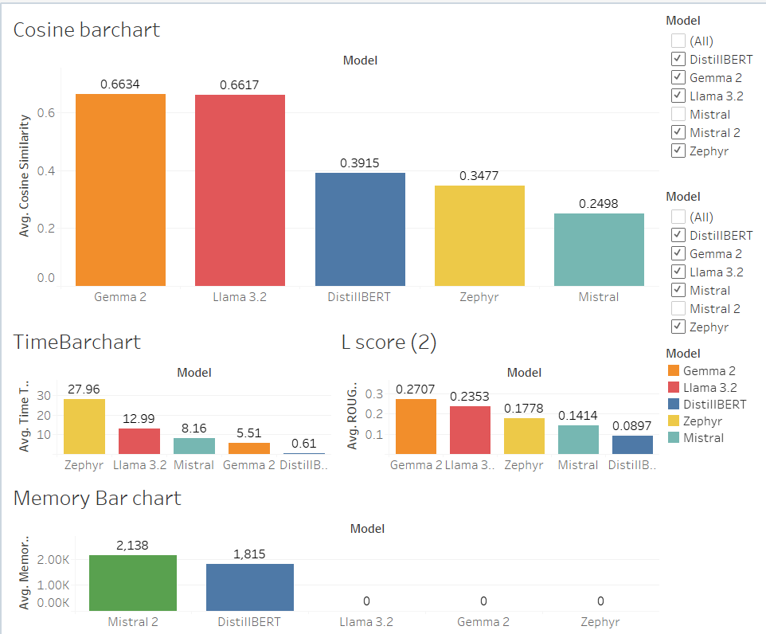
Average Metrics

Slide 16
Challenges and Solutions
Heavy Model Performance Issues:
Challenge: Initially used a heavyweight DistillBERT model which ran indefinitely and eventually crashed the system.
Solution: Switched to a lighter version of the model which significantly improved system stability and achieved an accuracy of 70%.
Resource Limitations in Google Colab:
Challenge: Encountered out-of-memory errors in Google Colab when handling multiple models simultaneously.
Solution: Transitioned to using Jupyter locally and implemented distributed processing, with each model running on a different team member’s system, optimizing resource usage.
Library Incompatibility in Jupyter Notebook:
Challenge: Faced library compatibility issues in Jupyter Notebook which hindered model execution.
Solution: Established isolated virtual environments for running each model separately. This approach resolved many compatibility issues, though some models still encountered problems.

Slide 17
Challenges and Solutions
4. Development Environment Optimization:
Challenge: Continued to experience incompatibility issues even within virtual environments.
Solution: Configured and utilized Visual Studio for virtual environments specifically tailored to the problematic models. This adjustment led to improved model responses with approximately 85% accuracy.

Slide 18
Conclusion
Streamlined Access: Improved access to Ontario's driving Acts by using 5 RAG models, each connected to a different LLM.
Efficient Retrieval: Provided fast, accurate answers for key regulations (e.g., Highway Traffic Act).
Overcoming Challenges: Addressed model performance, resource limitations, and compatibility issues with optimized solutions.
Future Expansion: Potential to improve accuracy, optimize models and expand to other languages and driving regulations.

Slide 19
Future Improvements
Disambiguation Models: allows the model to better handle ambiguous questions
Ex) if a question has multiple interpretations, the model could ask clarifying questions to select the correct meaning.
Low GPU: Making the model size smaller to prevent overfitting issues in the GPU
Applying other techniques to streamline data, categorizing them
Trying different methods to split the data in chunks and using semantics to evaluate results
Potential expansion for other languages

Slide 20
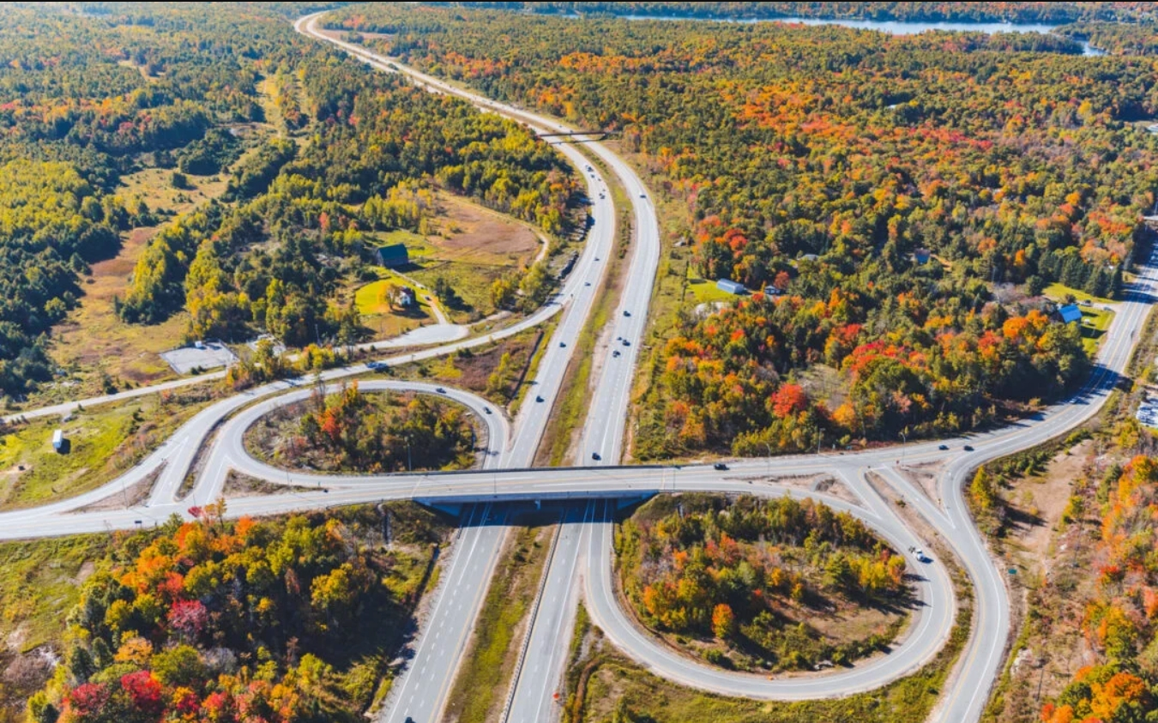
Thank You for Listening!

